Slide 1
Unsupervised/ Self-Supervised Learning
BY:
Shubham Mishra

Slide 2
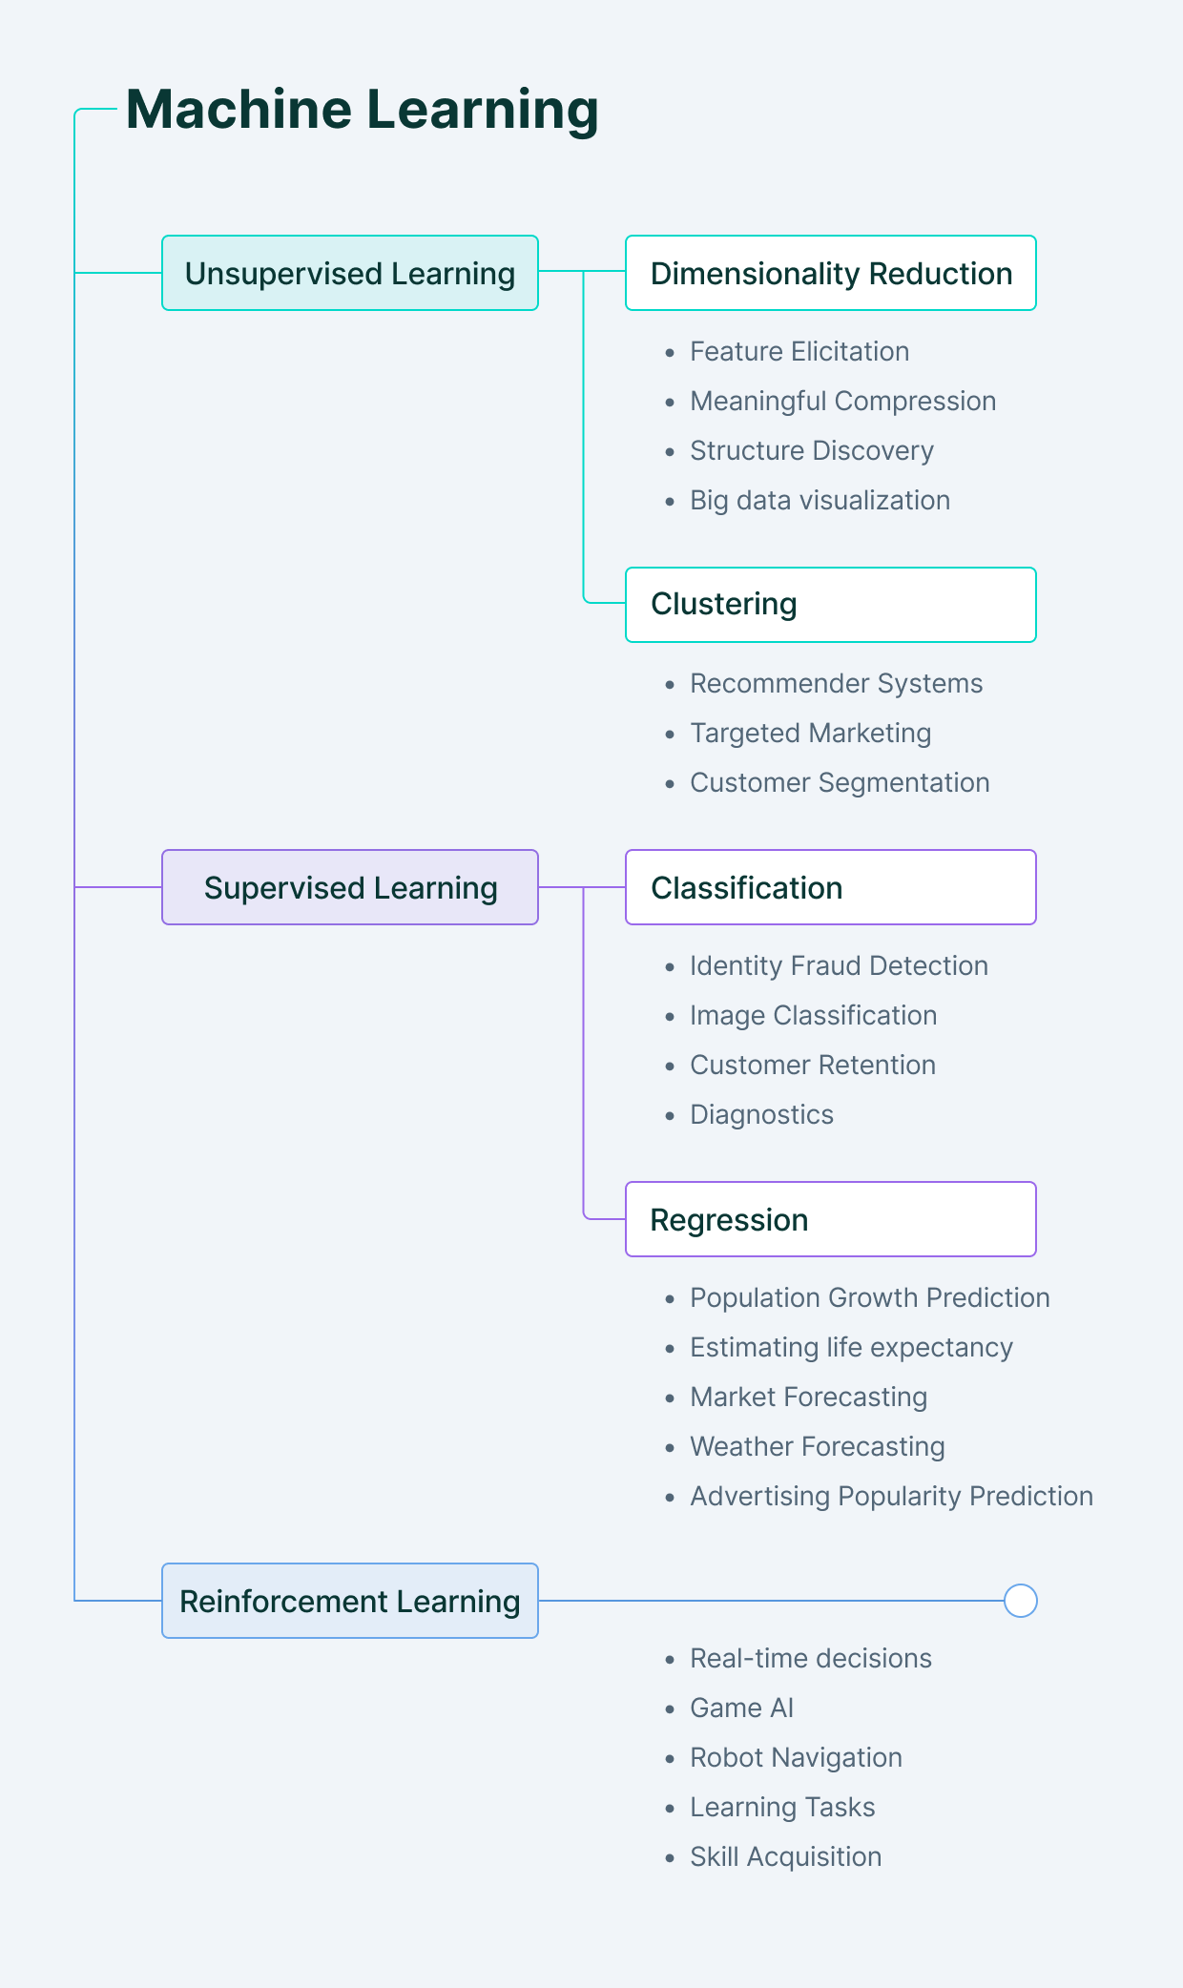
Recap of Unsupervised & Supervised ML

Slide 3
Continued…
Self-supervised Learning: Algorithm learns from the data itself with no labeled examples. The algorithm here finds structure in the data to learn from it.
Unsupervised Learning: Algorithm which is used to find the patterns in the data which are not labeled and is used when the data is too complex to be labeled. Unsupervised Learning is classified into 2 types; clustering and association rule learning algorithms.

Slide 4
Brief Overview
Going to cover 2 research papers:
Auto-Encoding Variational Bayes (Unsupervised Learning)
A simple Framework for Contrastive Learning of Visual Representations (Self-supervised learning)

Slide 5
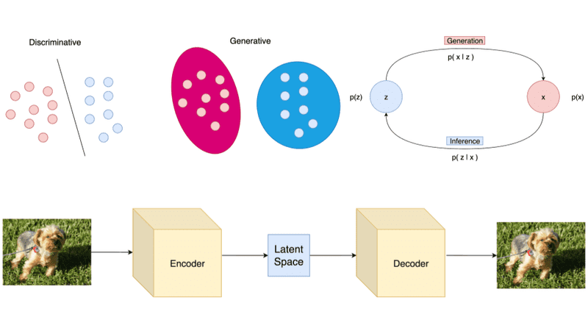
Introduction : Auto-Encoding Variational Bayes
What are latent variables?
Used to capture structure in data, part of more complicated system
Used in Large Probability Models
Main Aim of the first research paper?
To perform effective learning in presence of latent variables with posterior distribution and in large datasets.
FYI: Auto-encoding in Variational Bayes is an example of UNSUPERVISED LEARNING
Figure 1: Latent Variable Example

Slide 6
Methodology
Implement a lower bound estimator for variety of models with continuous latent variables.
Perform ML (Maximum Likelihood) and MAP (Maximum a posteriori interference)
Assumed dataset: X = {x(i)}Ni=1
Step 1: a value z(i) is generated from some prior distribution pθ∗ (z);
Step 2: a value x(i) is generated from some conditional distribution pθ∗ (x|z).
Assumption: prior pθ∗ (z) and likelihood pθ∗ (x|z) come from parametric families of distributions pθ (z) and pθ (x|z)
Notes:
This method can only be implemented to online , non stationary settings for example streaming data but for simplicity in this paper, the authors had assumed a fixed dataset.

Slide 7
When is this algorithm proposed effective?
When:
The intractabilities in the dataset are too common and they appear in cases of moderately functions for example: in deep neural networks with a nonlinear hidden layer
Working with large datasets which require expensive optimizations and requires sampling based solutions.
Notes:
Solving which problems:
Efficient approximate ML or MAP estimation for the parameters θ. The parameters can be of interest themselves, e.g. if we are analyzing some natural process.
Efficient approximate posterior inference of the latent variable z given an observed value x for a choice of parameters θ. This is useful for coding or data representation tasks.
Efficient approximate marginal inference of the variable x. This allows us to perform all kinds of inference tasks where a prior over x is required. Common applications in computer vision include image denoising, inpainting and super-resolution.

Slide 8
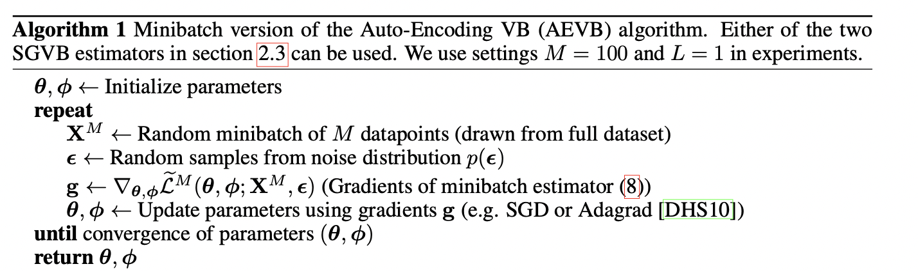
Using SGVB Estimator and AEVB Algorithm

Slide 9
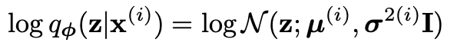
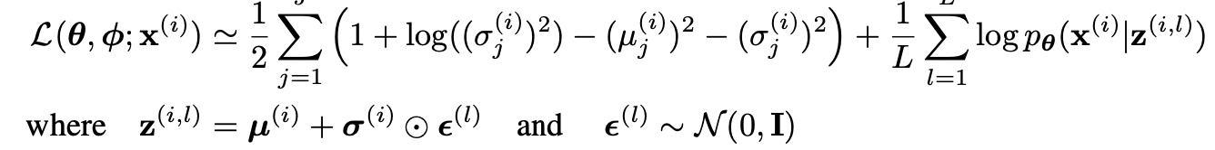
Continued…
Using variational auto encoder for probabilistic encoder and this is where the different parameters φ and θ join with the AEVB Algorithm
Variational approximate posterior with Gaussian covariance structure:
Hence the resulting estimator and datapoint x of i is:

Slide 10
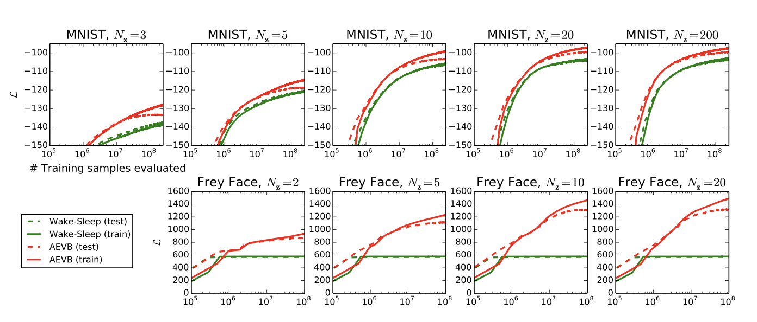
Using the solutions in Experiments
Generated encoder and decoder were used with Gaussian outputs
More latent variables don’t result in overfitting, method converged incredibly faster and reached better solution in all experiments.

Slide 11
Conclusion of first research paper
The advantages are clear as the algorithm runs faster and is efficient in real life scenarios.
For continuous latent variables: SGVB (Stochastic Gradient VB)
For i.i.d datasets: AEVB (Auto-Encoding VB)
More room for future development:
Learning hierarchical architectures within deep neural networks
Using time-series models
Application of SGVB in global parameters
Using supervised models with latent variables and analyzing outputs.

Slide 12
Introduction : A Simple Framework for Contrastive Learning of Visual Representations
Motivation: Introduce SimCLR for learning visual representations
Demonstration of:
Composition of data augmentations and how it plays an important role
Introducing a learnable nonlinear transformation
Contrastive learning benefits from larger batch sizes and large data sets.
Why choose SimCLR over its competitors?
Achieves top-1 accuracy as 76.5 %
7% improvements from its predecessor

Slide 13
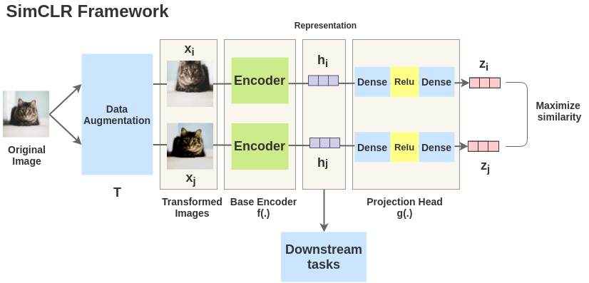
What’s the framework of SimCLR like?

Slide 14
Why SimCLR?
It is simpler, require no specialized architecture unlike the other competitors, and also does not require a memory bank
Major components of SimCLR Framework:
Composition of multiple data augmentation operations
Introducing a learnable nonlinear transformation
Representation learning with contrastive cross entropy loss
Contrastive learning helps supervised learning to benefit from deep and wide networks

Slide 15
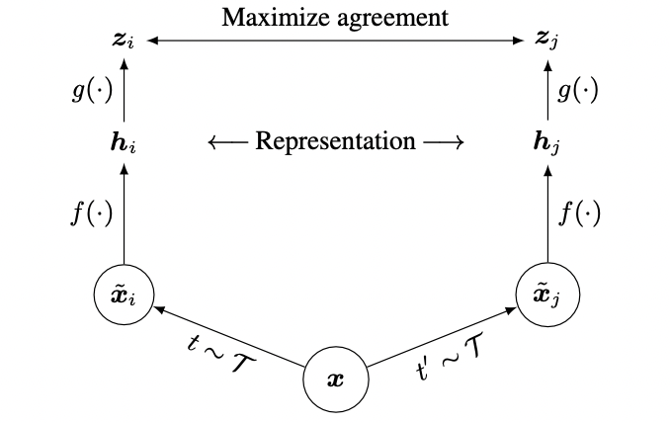
Methodology
4 major components of SimCLR:
- Data augmentation module
Base encoder f(·)
Projection head g(·)
Contrastive loss function

Slide 16
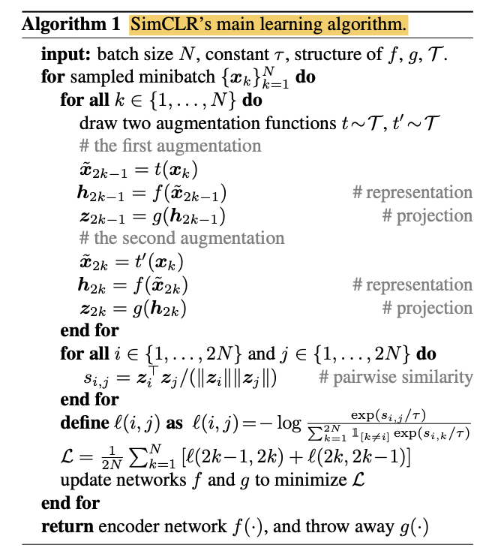
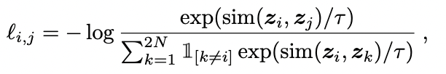
Continued…
Loss function for the variable pair (i,j) is:

Slide 17
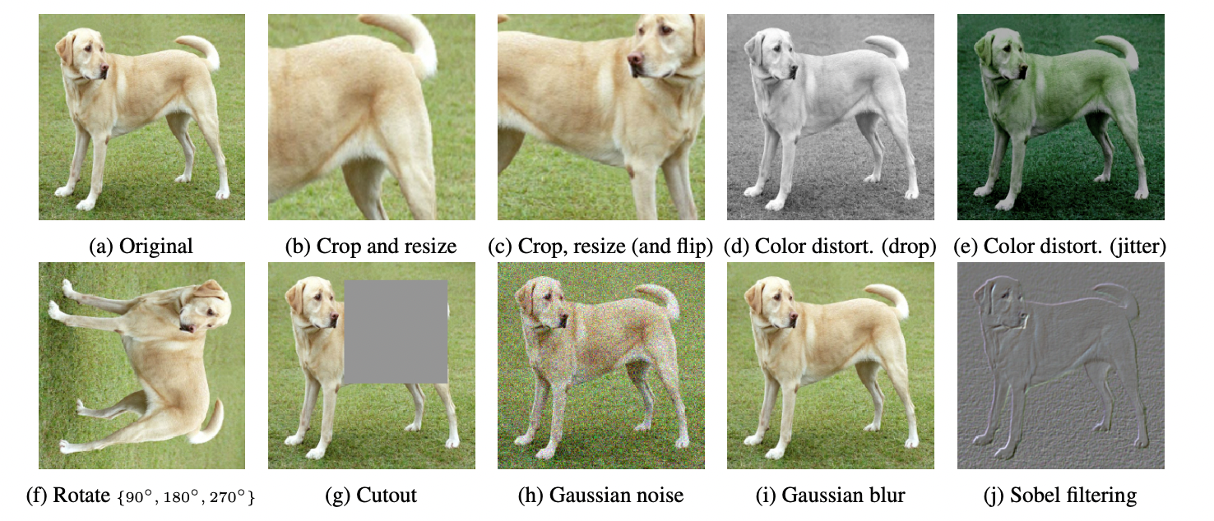
Implementation of SimCLR algorithm
Illustration of studied augmentation operators. Not a systematic way to define the contrastive prediction task, different approaches are tested for this.

Slide 18
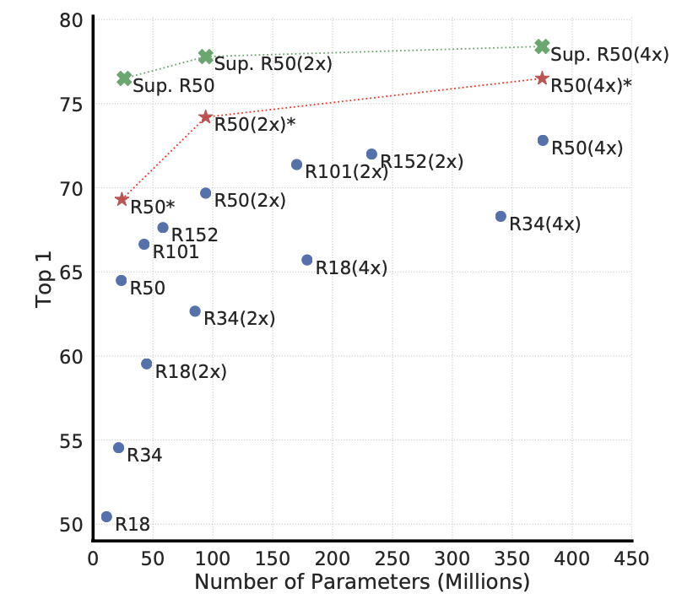
Illustration #2
Linear models with varied depth and width
Blue dots are trained for 100 epochs red stars are trained for 1000 epochs and green crosses are supervised for 90 epochs
Figure describes that increasing depth and width both INCREASES performance.
Hence, unsupervised learning benefits more from bigger models than its supervised counterpart.

Slide 19
Combining the findings
What was learnt from these summarized findings:
Nonlinear projection head improves representation quality of the layer
Normalized cross entropy loss with adjustable temperature works far superior than other alternatives suggested
Contrastive learning is more advantageous with larger batch sizes, larger datasets and longer training

Slide 20
Conclusion
What did we learn today?
By using different frameworks like SimCLR, we can still trust on using self-supervised learning algorithms
We improve our evaluation and implementation process efficiency by a lot just by implementing new self-supervised algorithms.

Slide 21
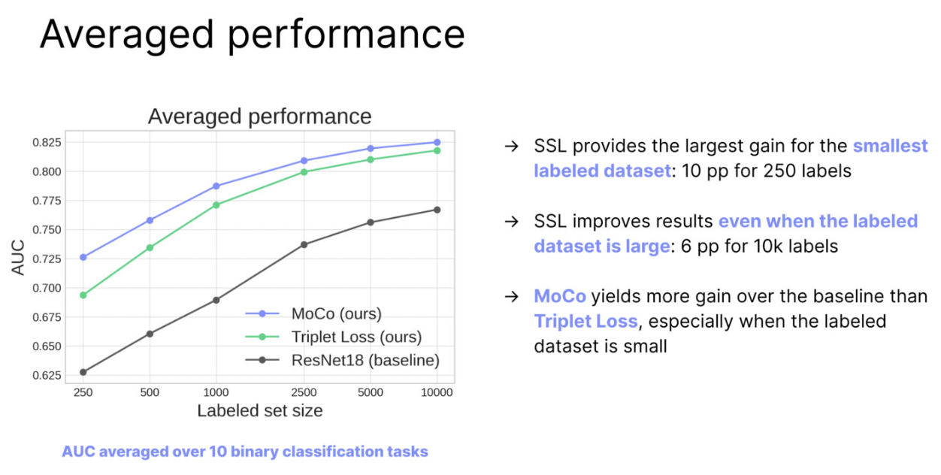
Discussion Questions
Why unsupervised machine learning is the future of cybersecurity?
How self-supervised can be used in the medical industry?
Notes:
In the cybersecurity area, most often hackers are using a method of attack the security program has not seen before in which a supervised machine learning algorithm would be completely useless. Hence, this is where unsupervised machine learning comes in. Here, the unsupervised learning draws inference from datasets without labels and it is best used to find patterns when you don’t know what you are exactly looking for.
Labeling medical data is extremely challenging, as there is compliance in gathering data, multiple incompatible formats of data are used, and there are several internal biases like the existence of rare diseases, and moreover, solving all these problems require time and money. However, self supervised learning can be used to train several diseases classification models on data with few annotated examples. The key elements of transfer learning is that the model learns with the from the general knowledge approach.

Slide 22
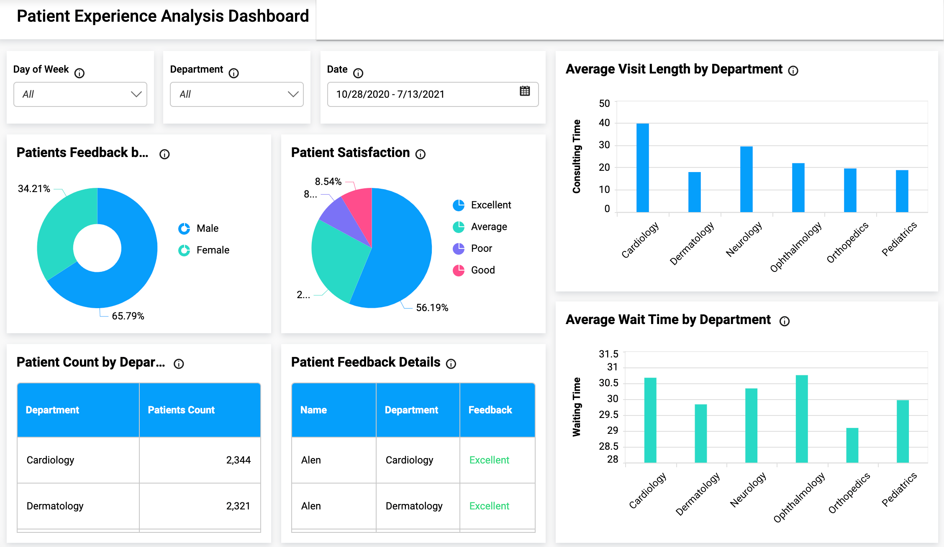

Slide 23
References
https://www.cs.cmu.edu/~rsalakhu/papers/eval_latents.pdf
Figure 1: https://theaisummer.com/latent-variable-models/
https://sh-tsang.medium.com/review-simclr-a-simple-framework-for-contrastive-learning-of-visual-representations-5de42ba0bc66
https://towardsdatascience.com/review-on-self-supervised-contrastive-learning-93171f695140
https://medium.com/imagescv/learning-supervised-unsupervised-self-supervised-semi-supervised-aa0a5d6d7010
https://technative.io/why-unsupervised-machine-learning-is-the-future-of-cybersecurity/
https://tooploox.com/self-supervised-learning-in-healthcare

